Slide 1
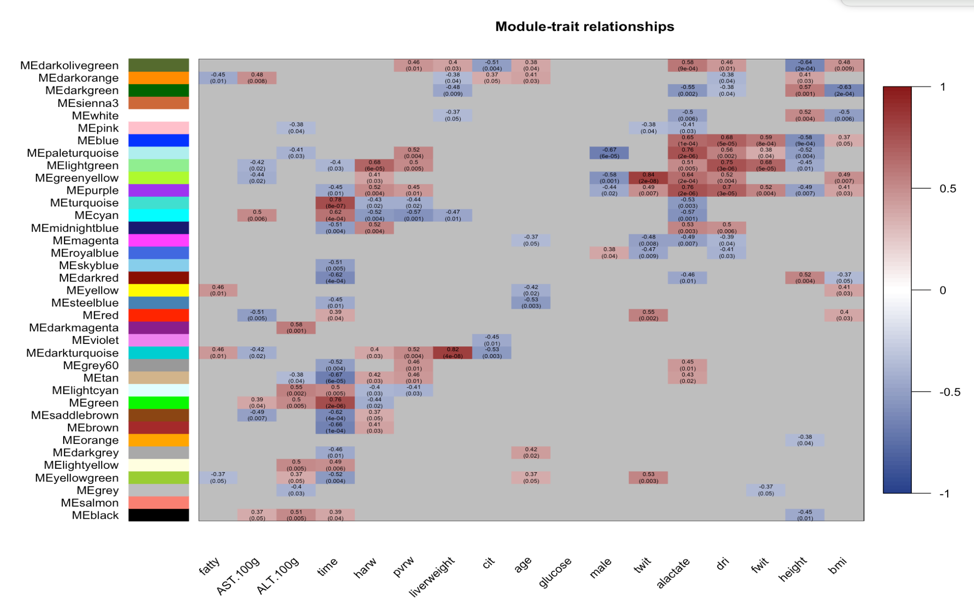
correlation between module eigengene and trait
Steatosis
AST
ALT
Time
HArw
PVrw
CIT
Glucose
Sex
TWIT
Lactate
DRI
FWIT
Height
BMI
Liver Weight
Donor Age

Slide 2
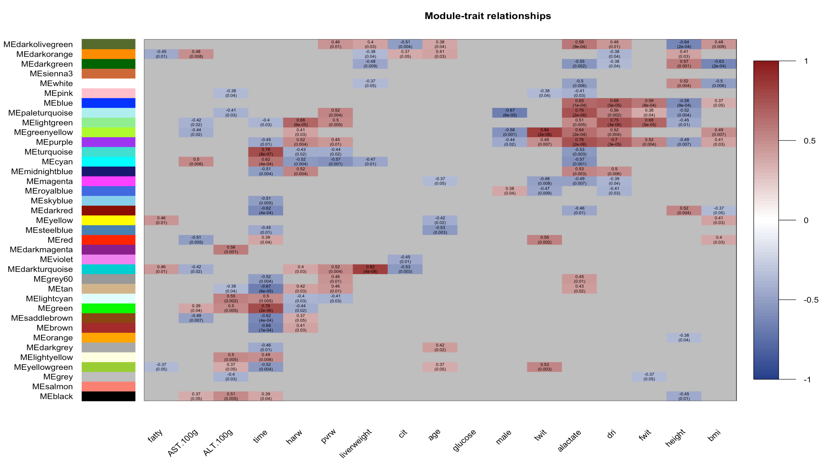
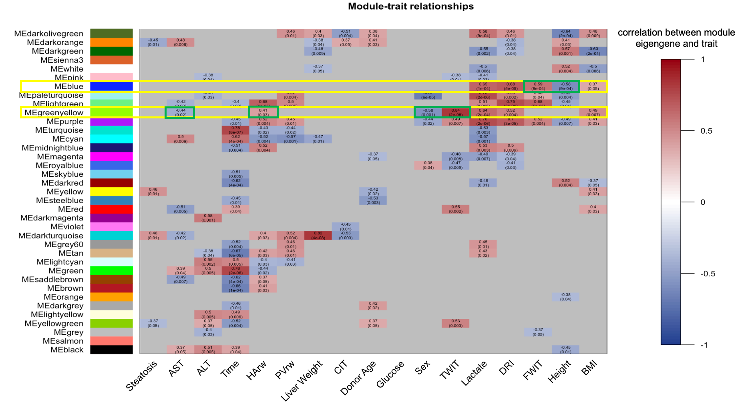
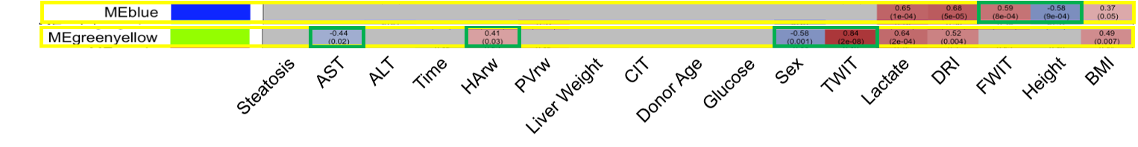

Slide 3
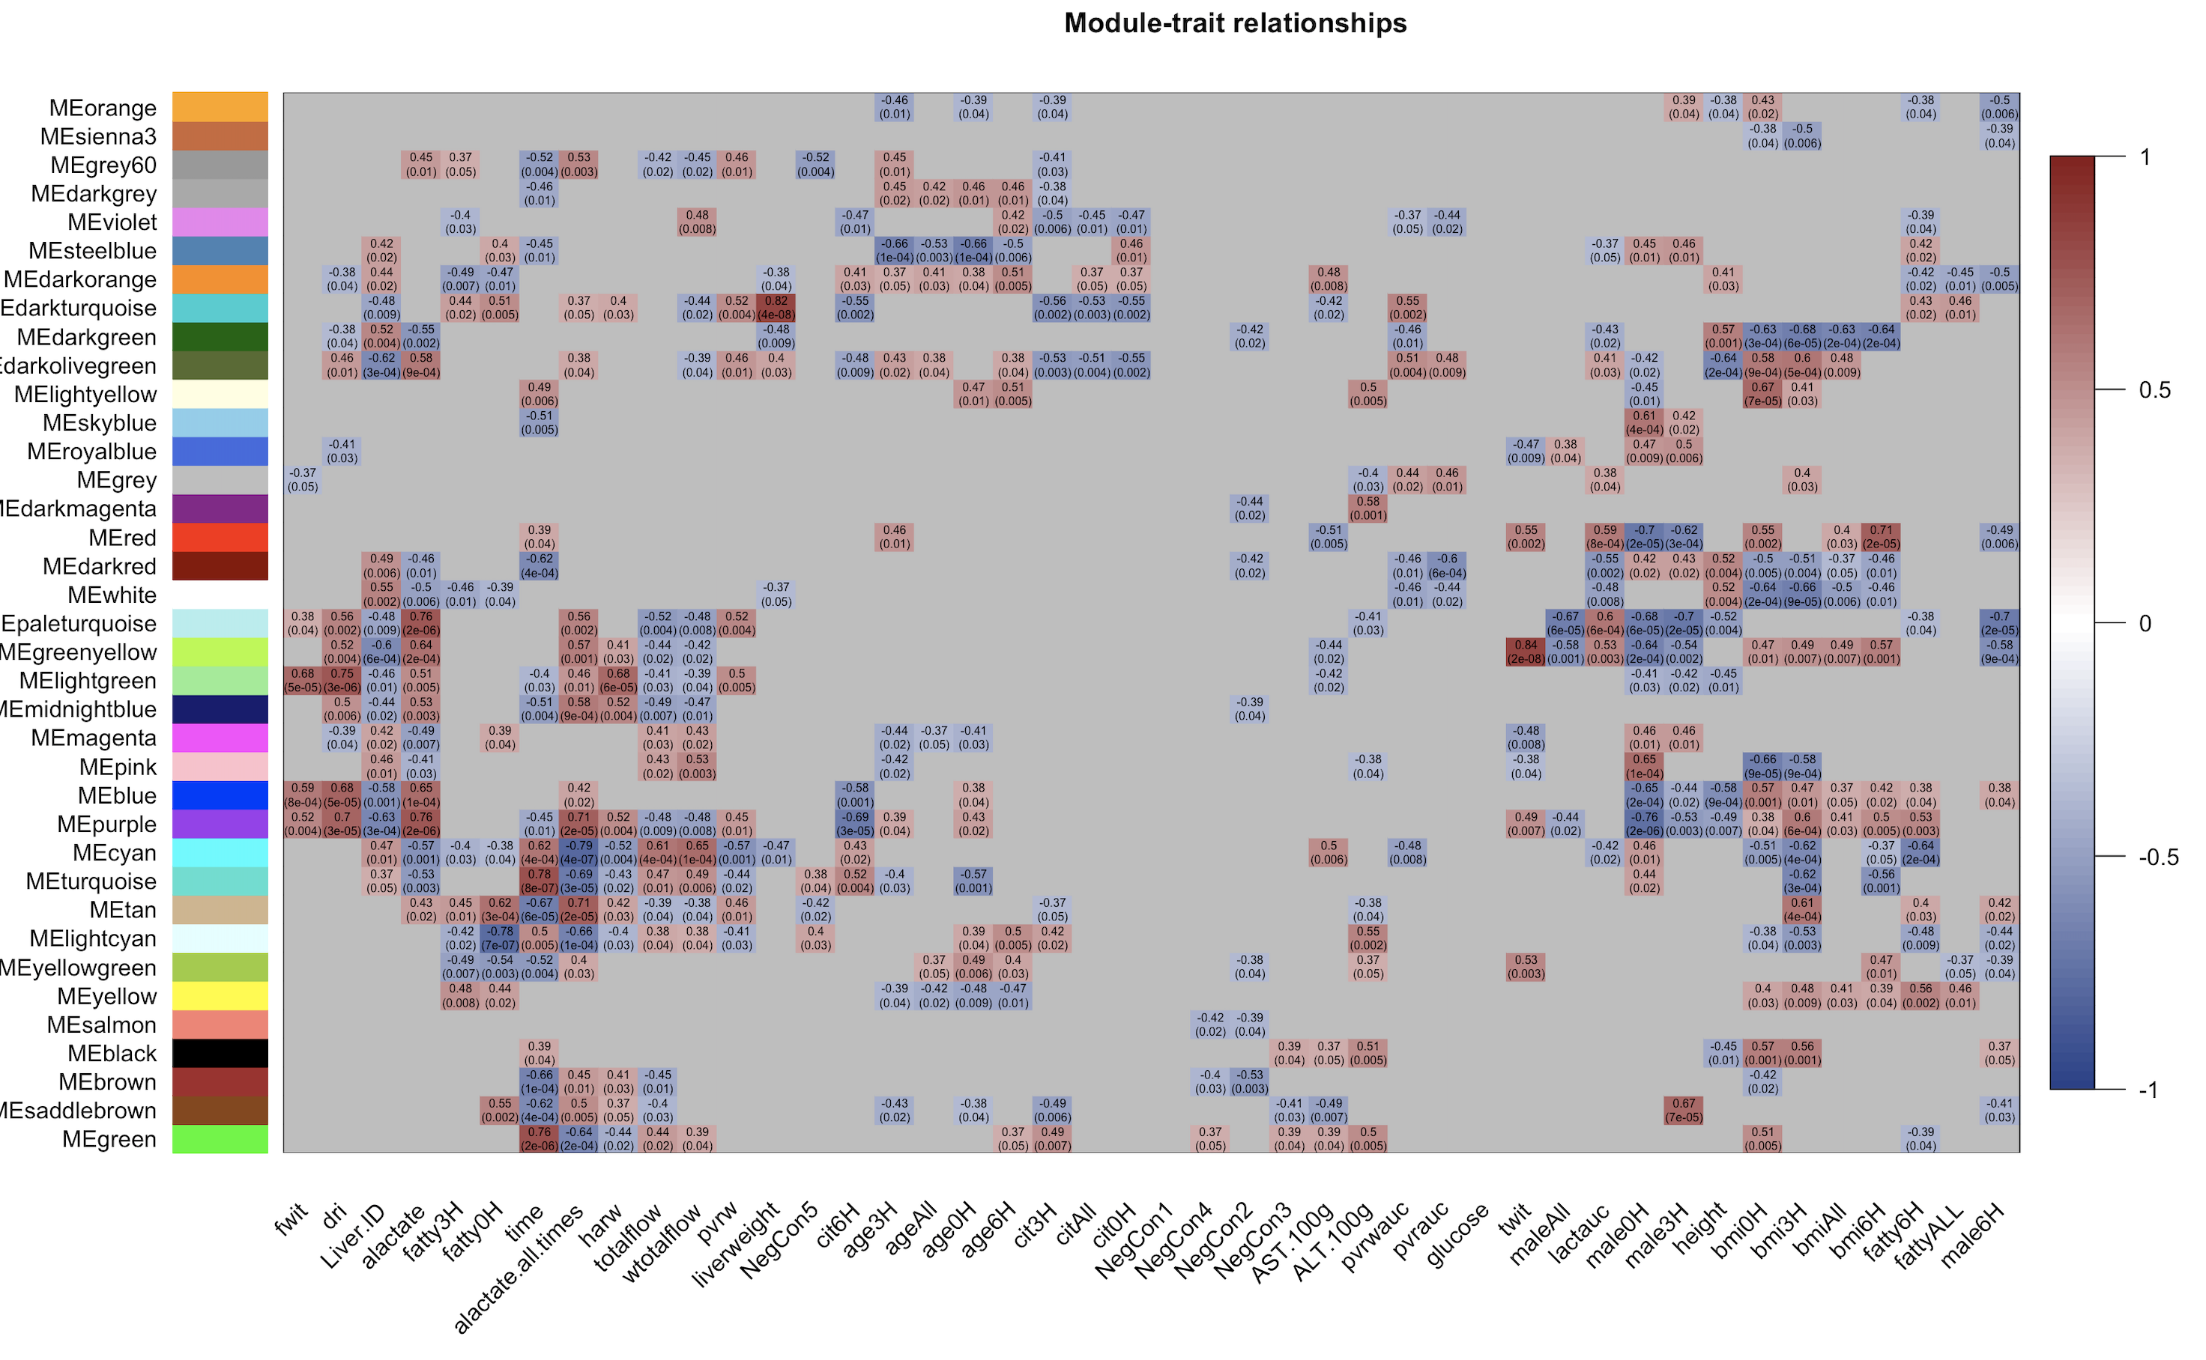

Slide 4
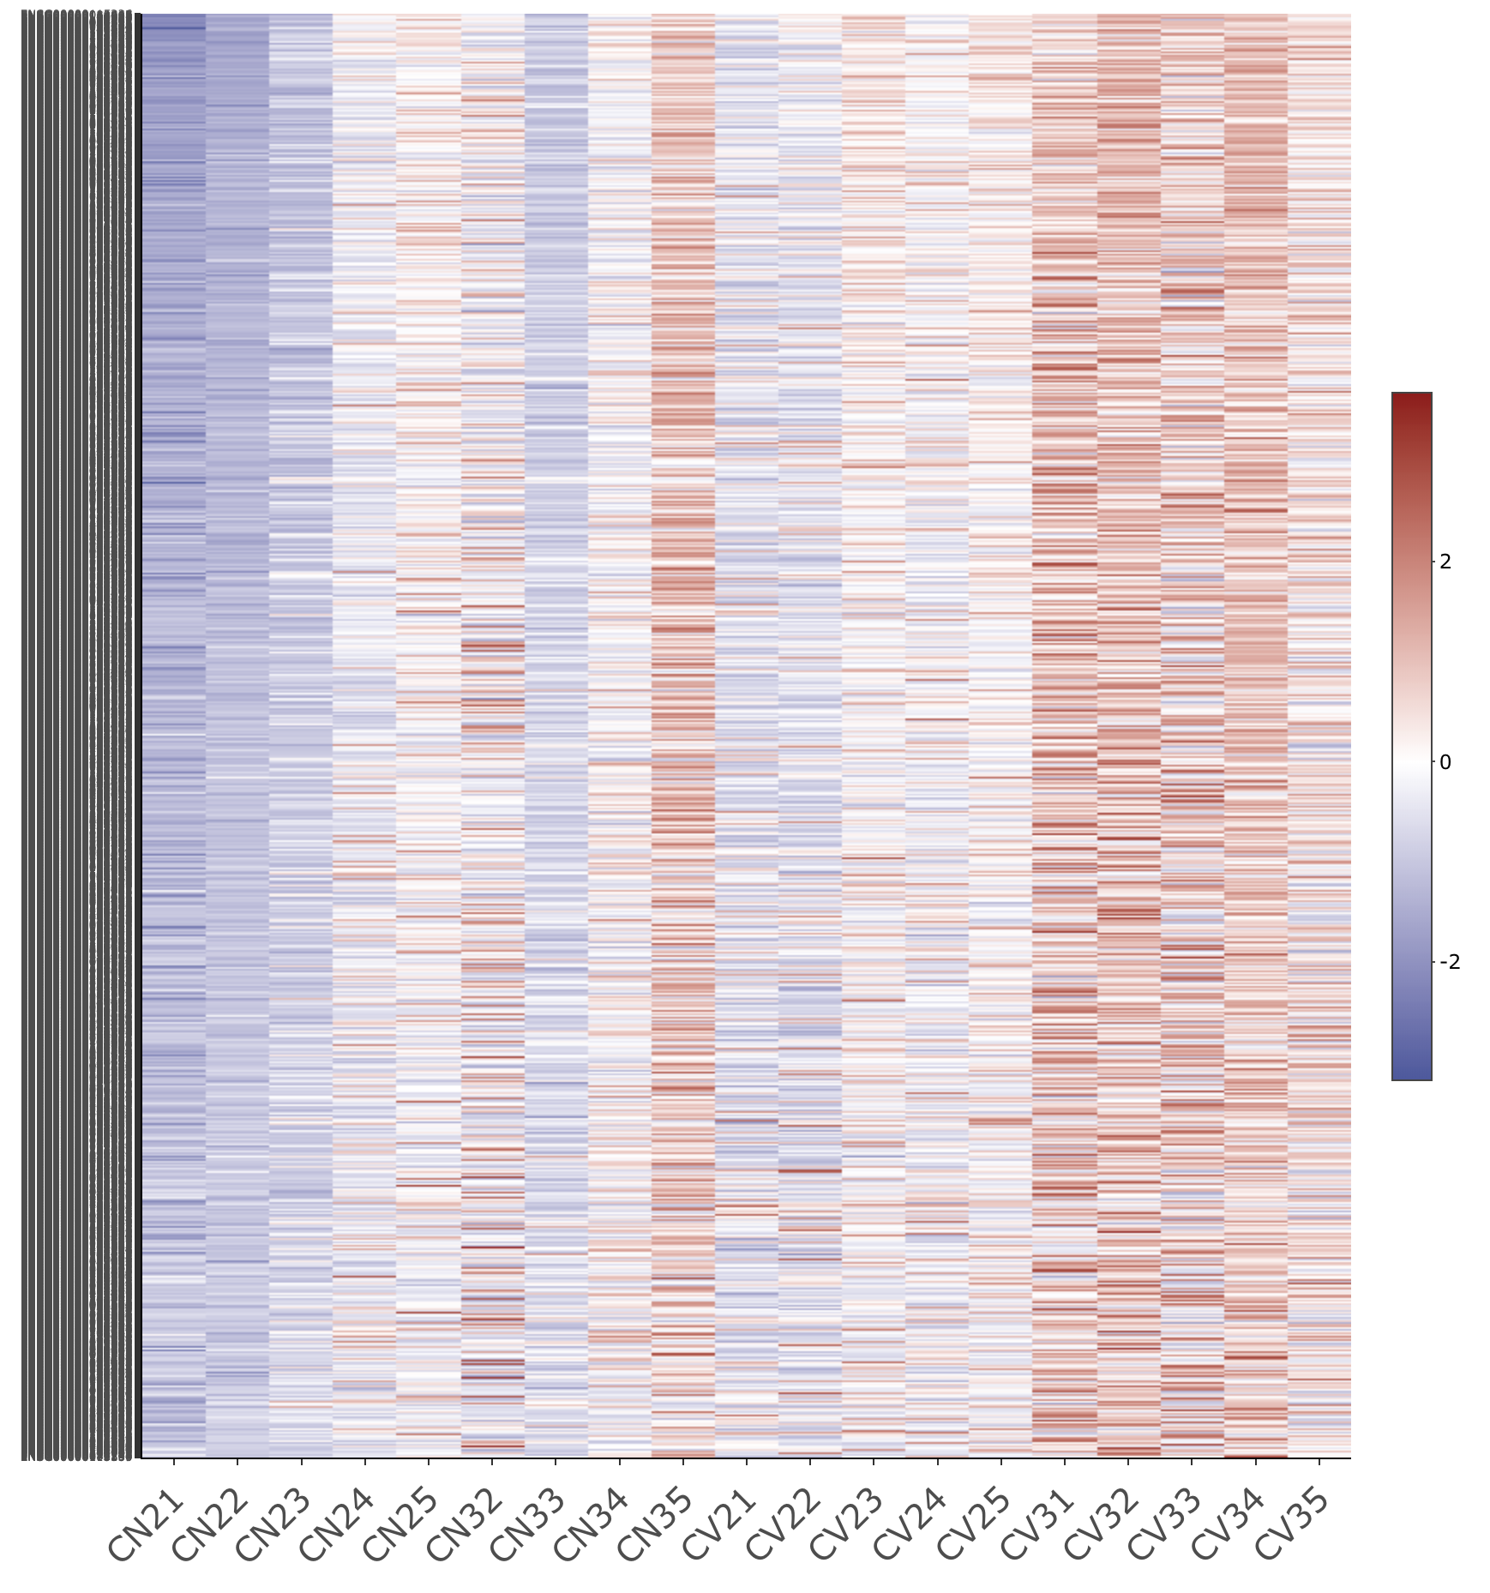
3 Hours NMP
6 Hours NMP
3 Hours NMP
6 Hours NMP
Livers with inadequate function
Livers with adequate function

Slide 5
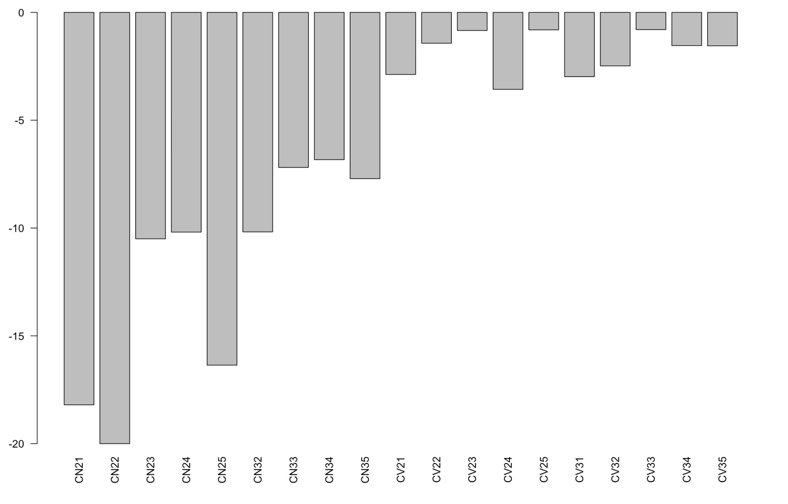
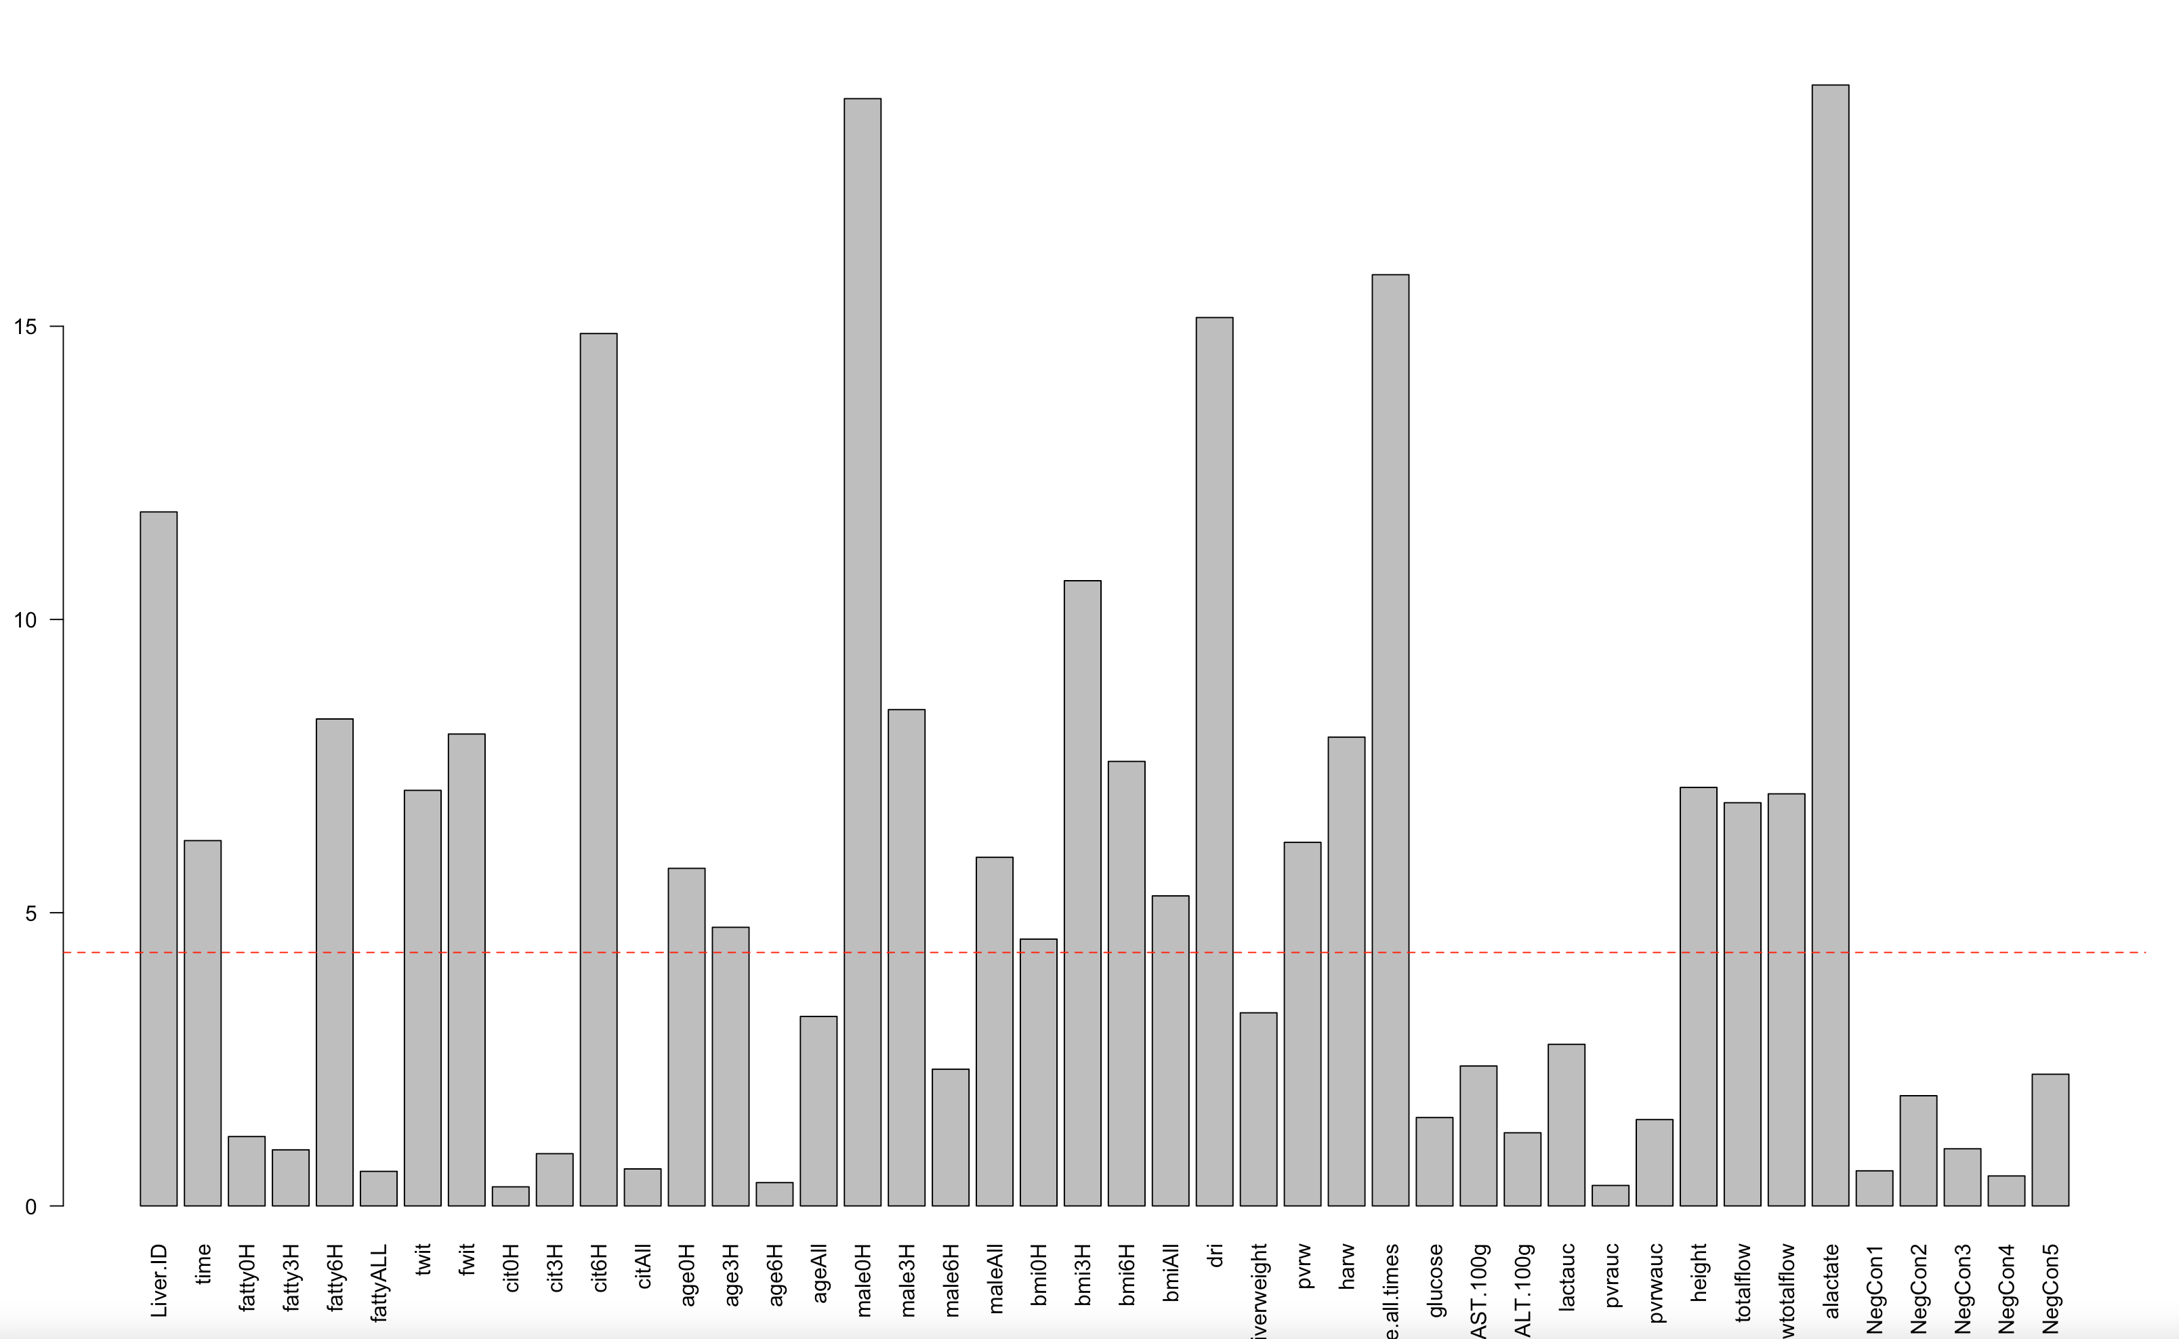
20
15
10
Lactate mmol/L
5
0
3 Hours
6 Hours
3 Hours
6 Hours
Nonviable
Viable
3 Hours
6 Hours
3 Hours
6 Hours

Slide 7
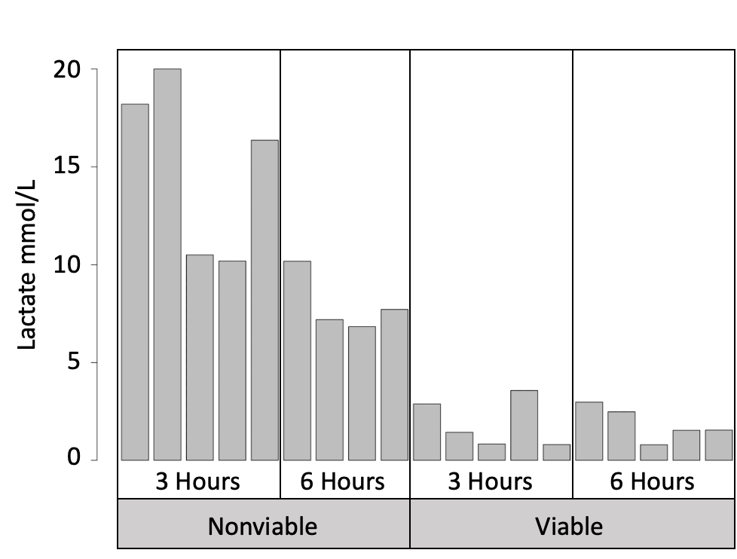

Slide 8
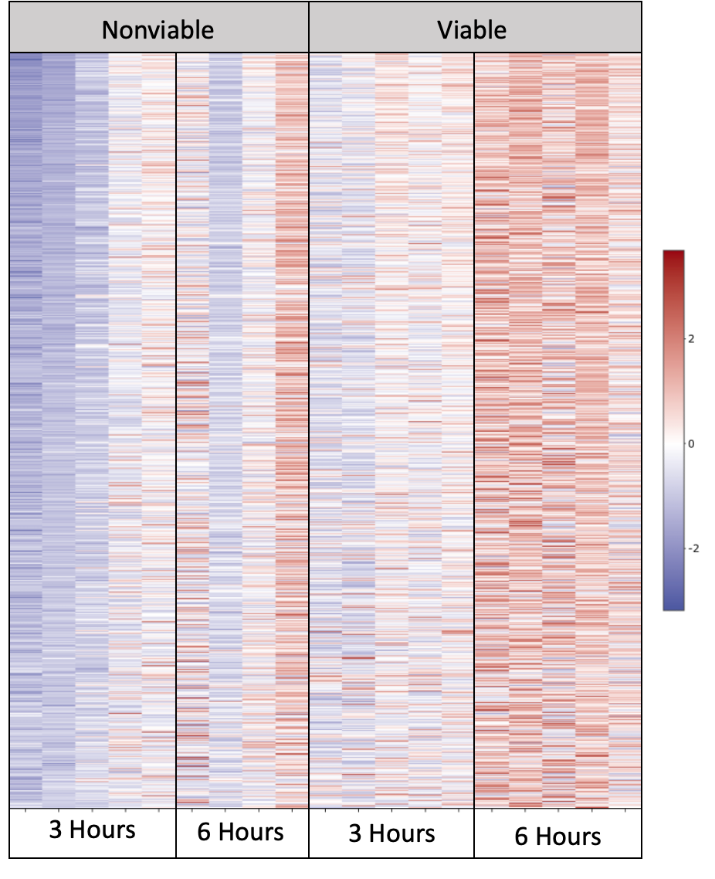
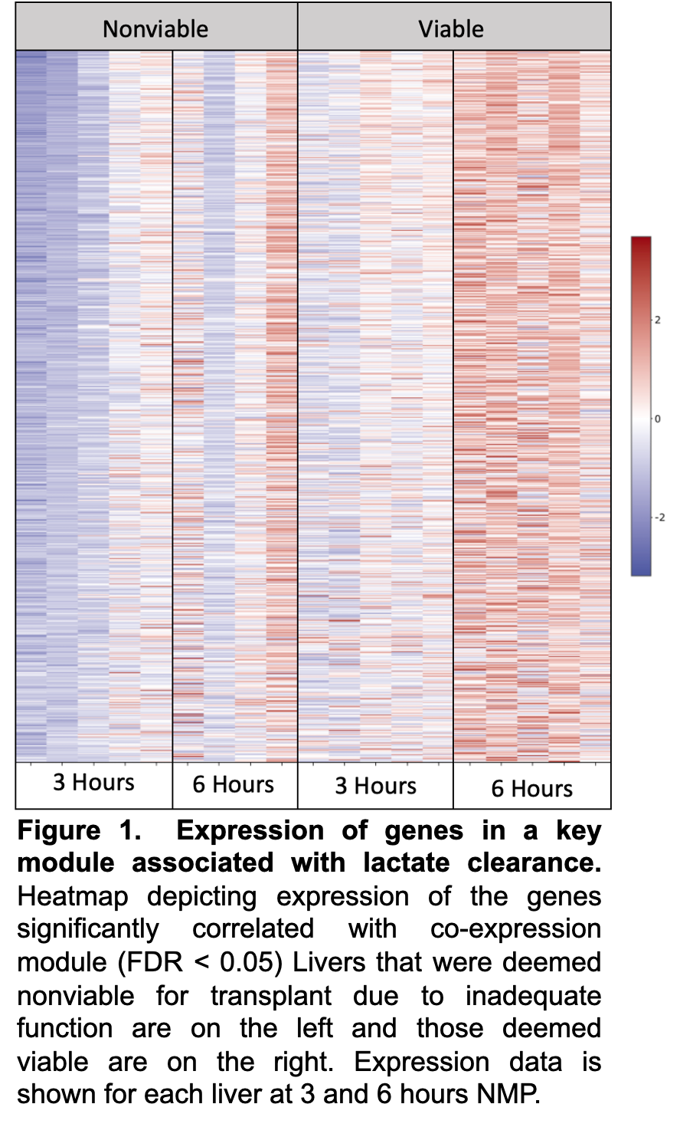
Figure 1. Expression of genes in a key module associated with lactate clearance. Heatmap depicting expression of the genes significantly correlated with co-expression module (FDR < 0.05) Livers that were deemed nonviable for transplant due to inadequate function are on the left and those deemed viable are on the right. Expression data is shown for each liver at 3 and 6 hours NMP.

Slide 9
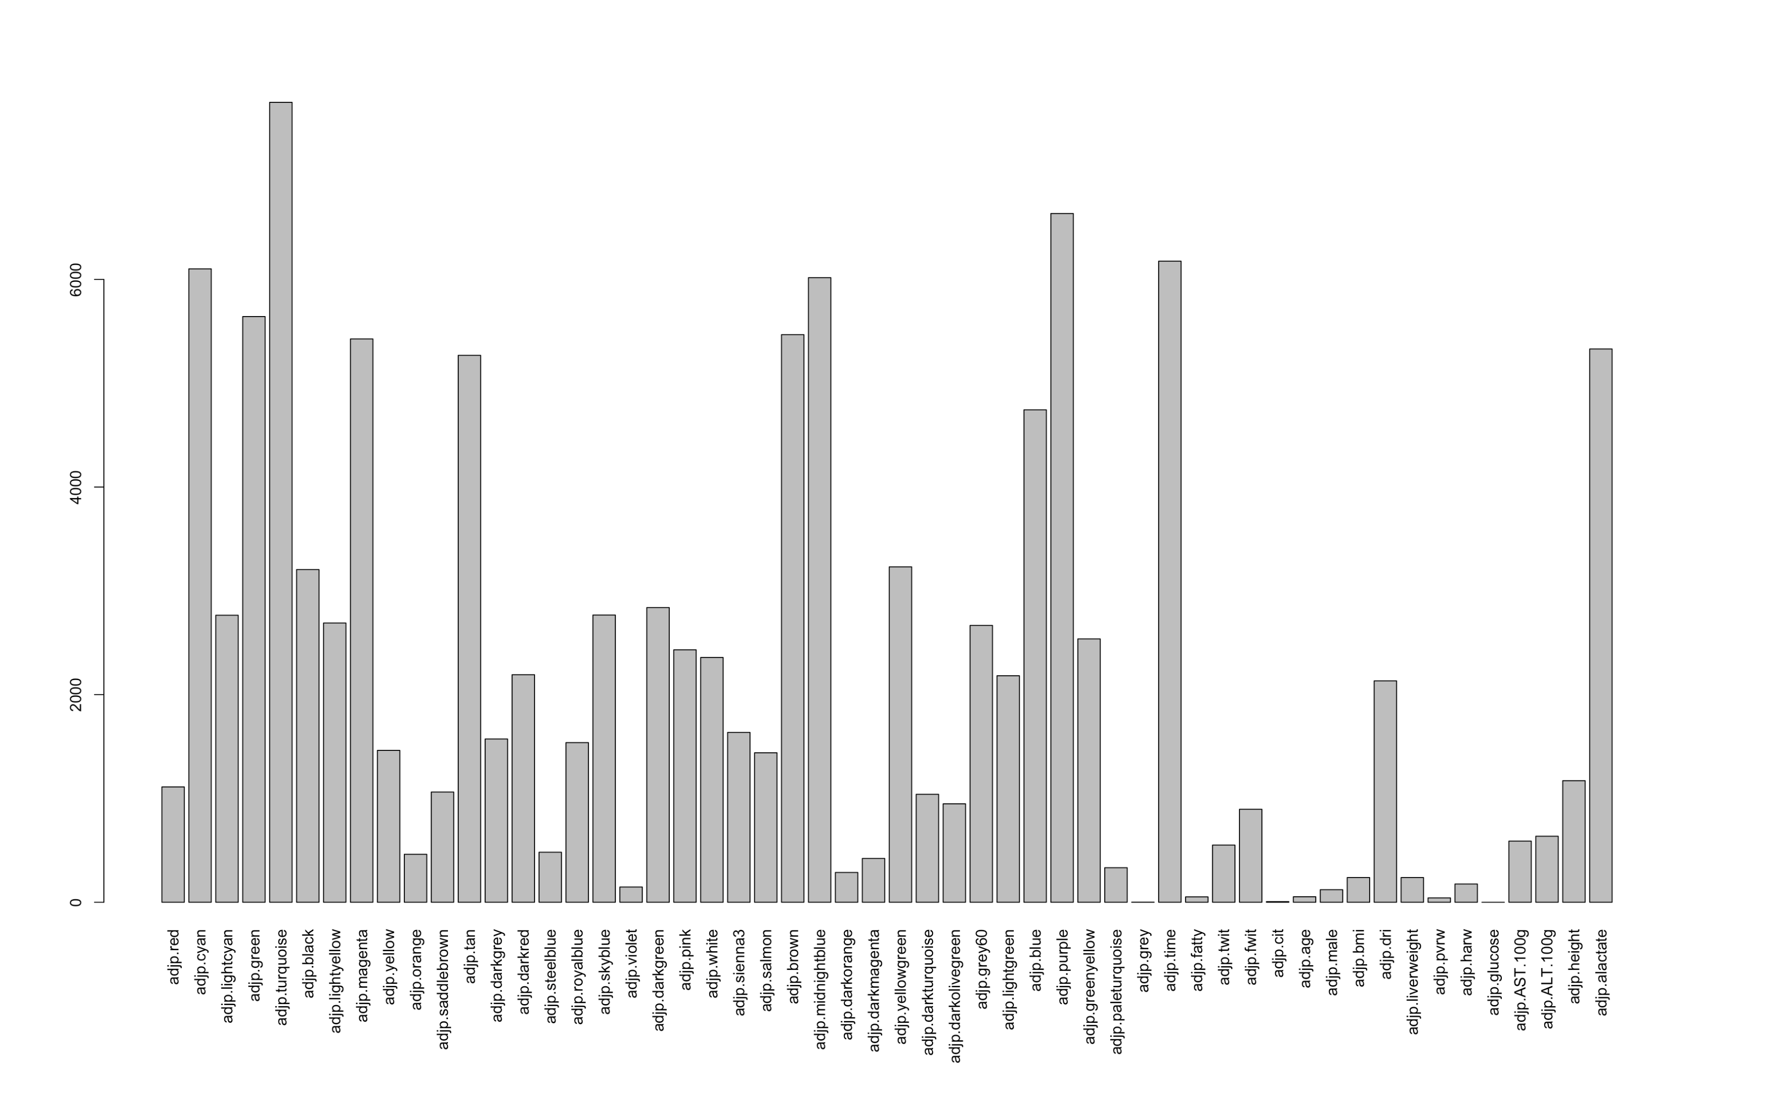

Slide 10
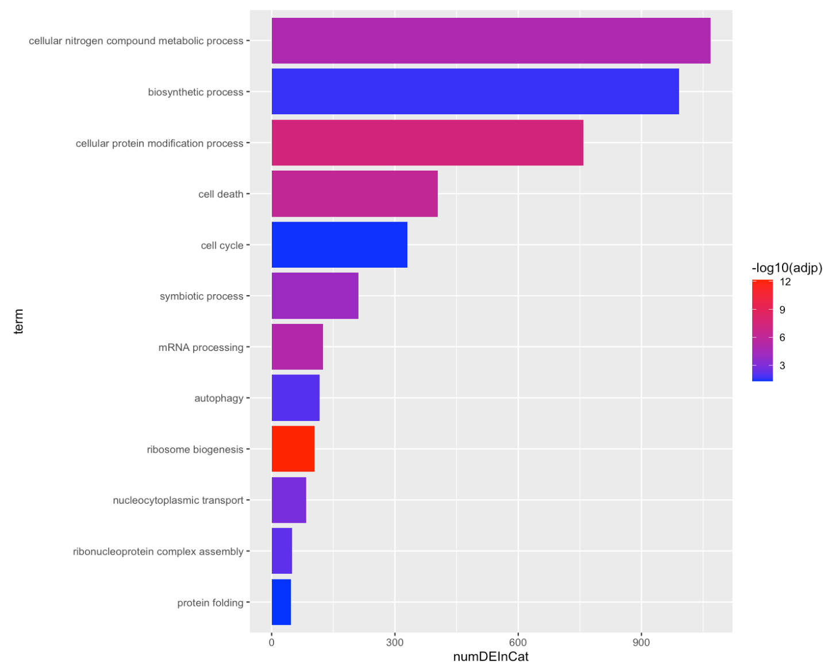
Cellular nitrogen compound metabolic process
Biosynthetic process
Cellular protein modification process
Cell death
Cell cycle
Symbiotic process
GOslim Biological Process
mRNA processing
Autophagy
Ribosome biogenesis
Nucleocytoplasmic transport
Ribonucleoprotein complex assembly
Protein folding
Total sig. DEG in Category

Slide 11
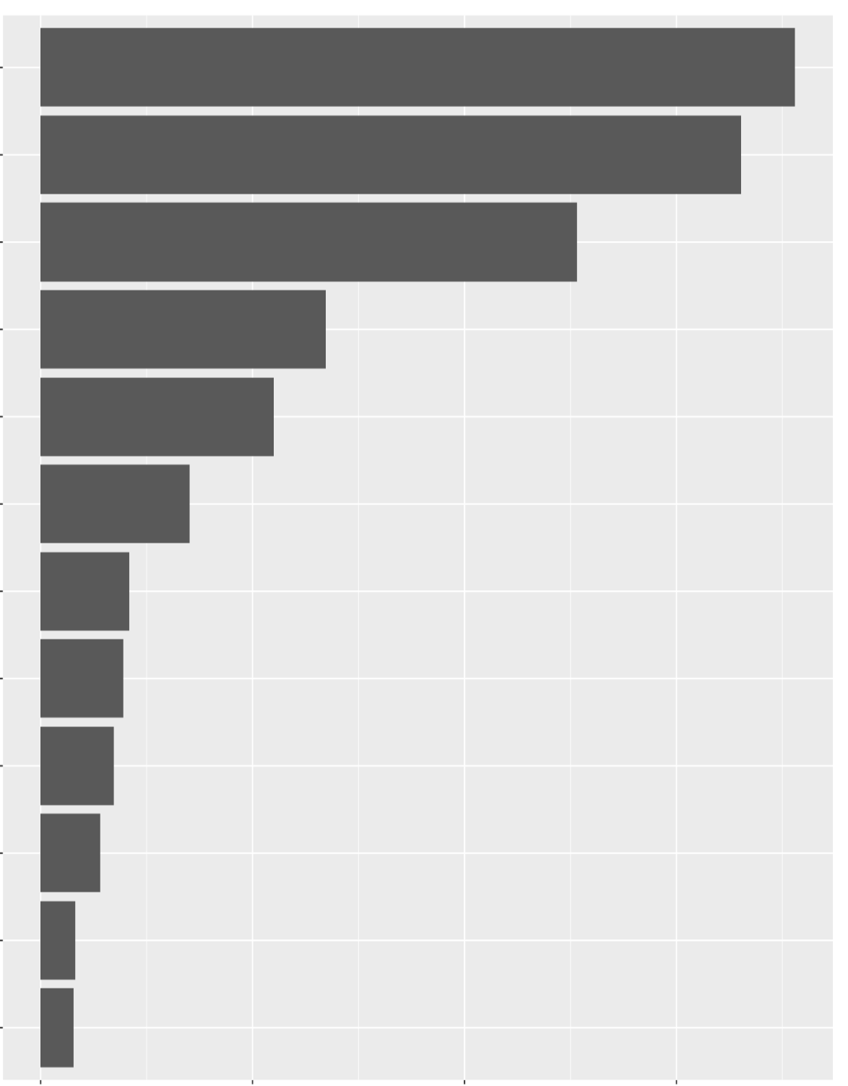
Cellular nitrogen compound metabolic process
Biosynthetic process
Cellular protein modification process
Cell death
Cell cycle
Symbiotic process
GOslim Biological Process
mRNA processing
Autophagy
Ribosome biogenesis
Nucleocytoplasmic transport
Ribonucleoprotein complex assembly
Protein folding
0
300
600
900
Total sig. DEG in Category

Slide 12
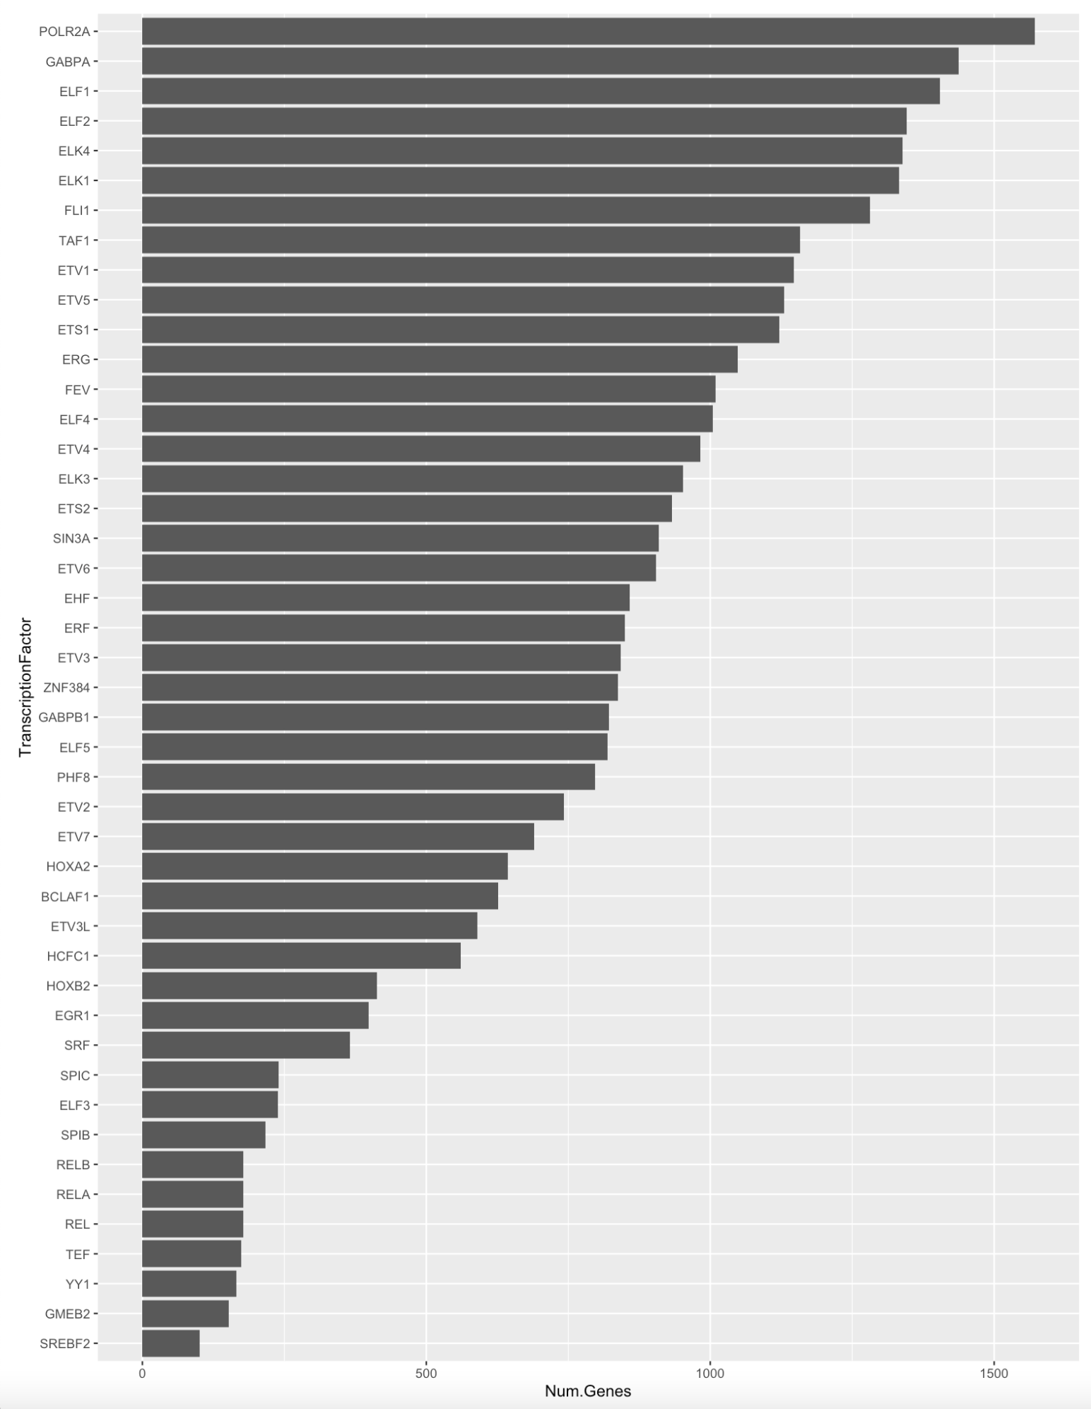
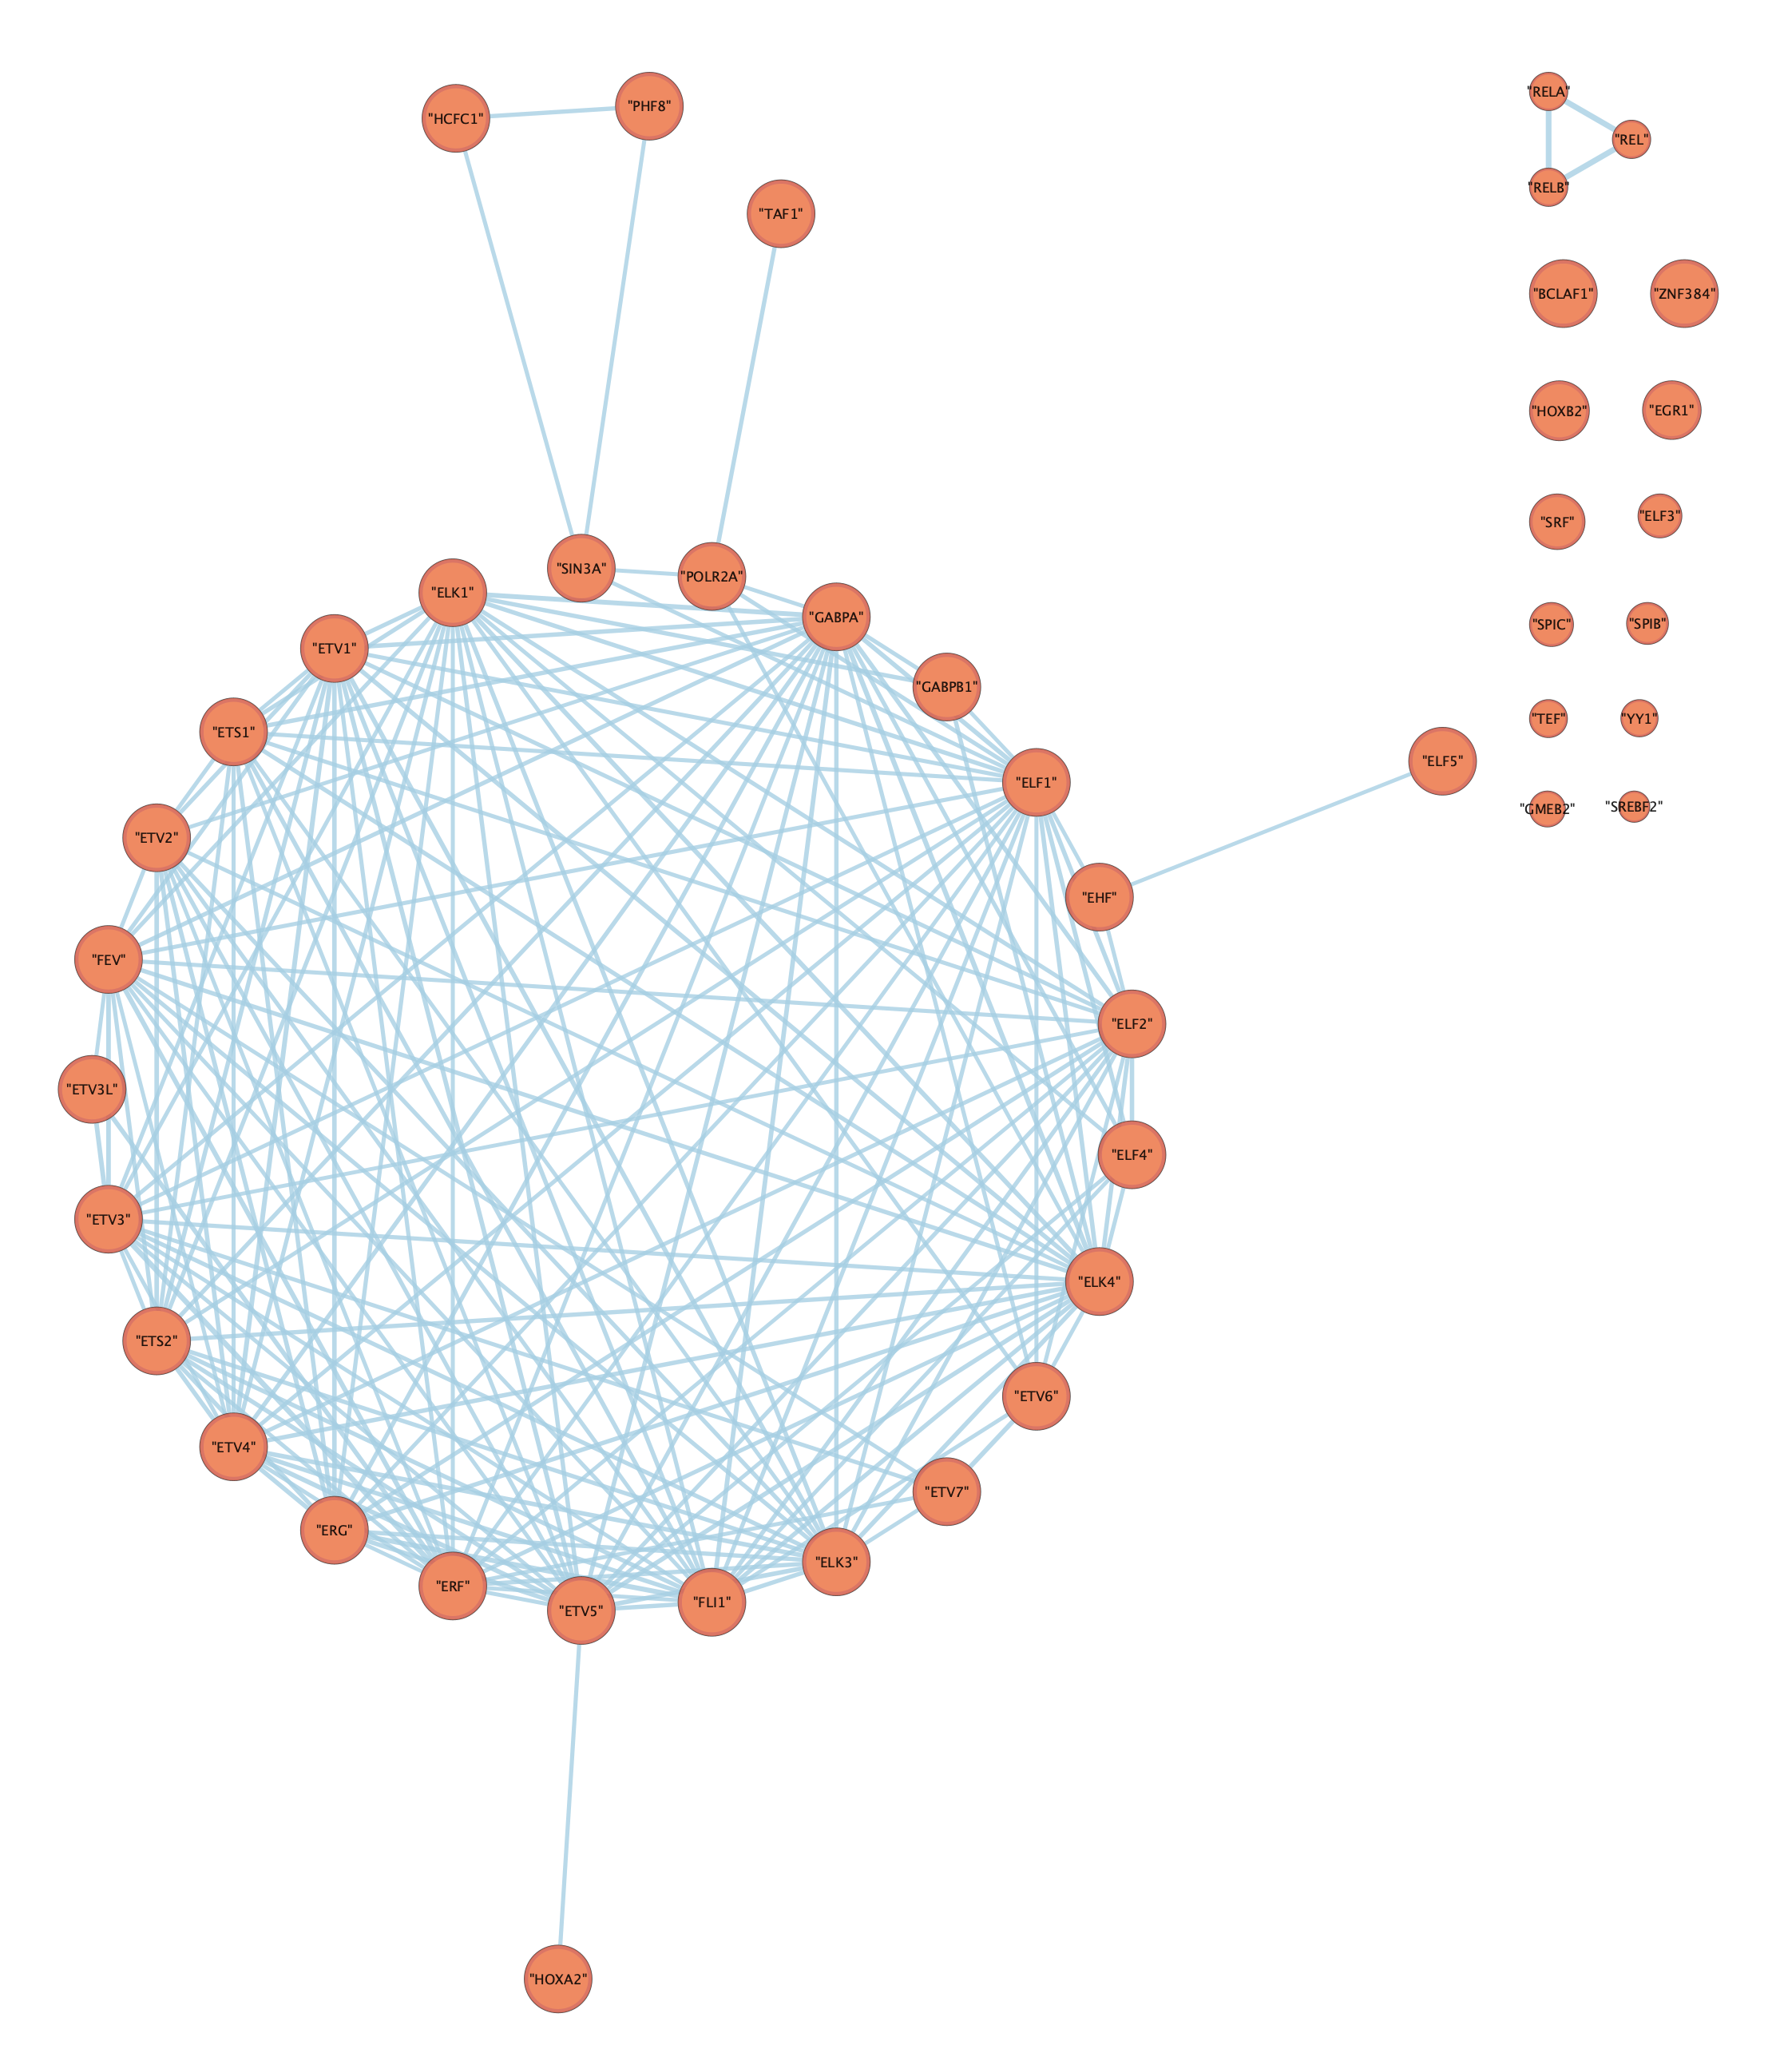

Slide 13
